Slide 1

Visualizing Keyboard Pattern Passwords
Dino Schweitzer, Jeff Boleng,
Colin Hughes, Louis Murphy
Oct 2009

Slide 2
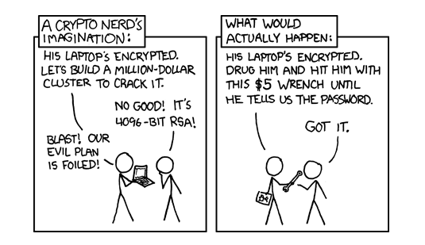

Slide 3
Overview
Background
Project Approach
Collecting Data
Visualizing
Results

Slide 4
Background
Introductory computer security course
2-person research projects
Complete research process
Faculty mentors
Work on “real problems”
Murphy / Hughes team wanted to investigate keyboard patterns

Slide 5
The problem
Hypothesis that a lot of people use keyboard patterns to meet password rules while creating a memorable key sequence
Appear random when look at text
Not in dictionaries
Easy to remember
Are such patterns vulnerable to attack?

Slide 6
Sample Password Rules
The password must be at least 8 characters long.
The password must contain at least:
one uppercase and one lowercase alpha character [a-z A-Z];
one numeric character [0-9];
one special character from this set: ` ! @ $ % ^ & * ( ) - _ = + [ ] ; : ' " , < . > / ?
The password must not:
contain spaces;
begin with an exclamation [!] or a question mark [?];
contain your login ID.
The first 3 characters cannot be the same.
The sequence of the first 3 characters cannot be in your login ID.
The first 8 characters cannot be the same as in your previous password.
Passwords are treated as case sensitive.

Slide 7
Project Approach
Collect a bunch of passwords
Analyze for patterns
Identify common patterns
Come up with way of using common patterns to attack a password file
Show proof of concept on a real password file

Slide 8
Collecting Passwords
Wanted a large sample size
Ideally, people would not know purpose of samples (or even that they were being collected)
Also, ideally, have some that know are intended as patterns, versus random ones

Slide 9
Collecting Passwords
Wanted a large sample size
Ideally, people would not know purpose of samples (or even that they were being collected)
Also, ideally, have some that know are intended as patterns, versus random ones
SOLUTION
Our Freshman class!

Slide 10
Password WebLab
Set of 7 web pages designed to teach freshmen about passwords
Strength, entropy, common attacks, different types
Interactive applets to (hopefully) make more compelling and encourage participation
Had them enter random, pattern, passphrases
Anonymously collected all passwords for analysis

Slide 11
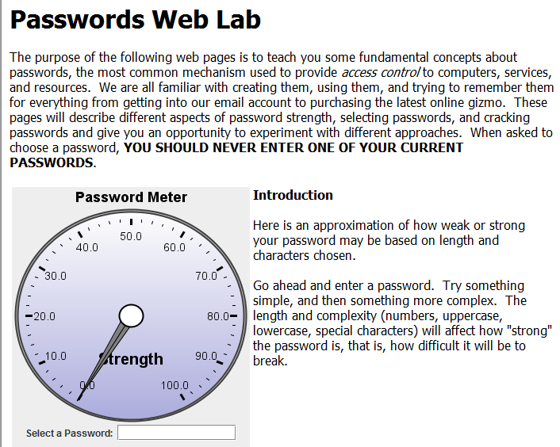
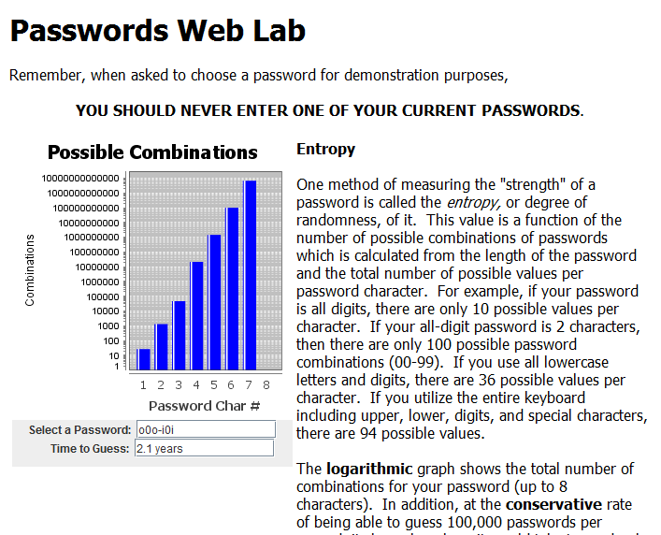
Screen Shots

Slide 12
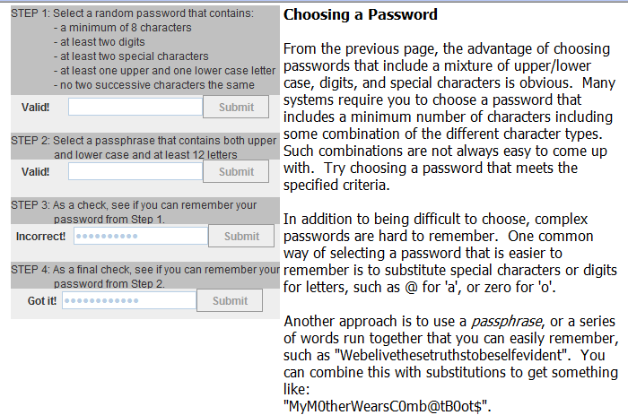
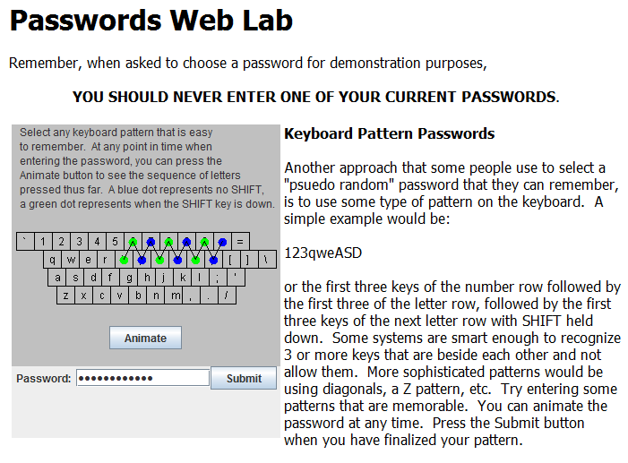
Screen Shots

Slide 13
Collected Data
161 distinct users
Over 500 “random” passwords
Over 250 “pattern” passwords
Based on collected passwords, it was obvious students did not know they were being saved

Slide 14
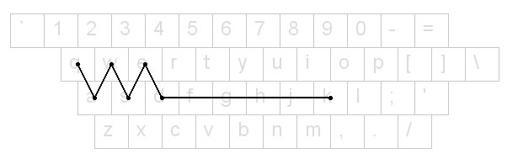
Visualizing Patterns
First attempt to simply draw lines between characters on keyboard
Some patterns obvious
Did not show same key hits
Could not tell when sequence repeated
Could not tell when shift key pressed
Also played with animating sequence
Hard to compare multiple passwords for common patterns

Slide 15
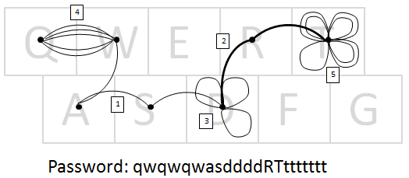
Drawing Rules
Connect keys with an arc
Increase the weight for shift
Loops for same key
Repetition uses offset arcs
Repetition of same key more than 4, offset loops
Arcs drawn in clockwise order

Slide 16
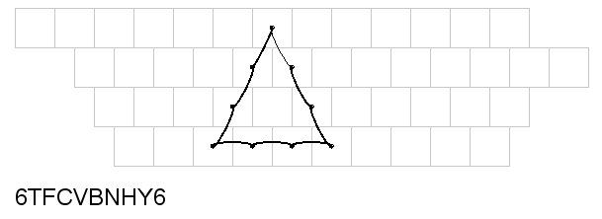
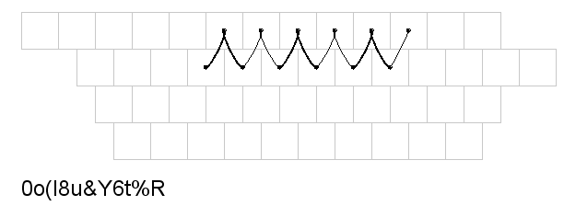
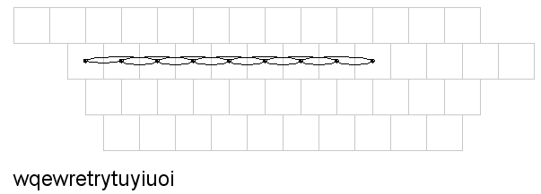
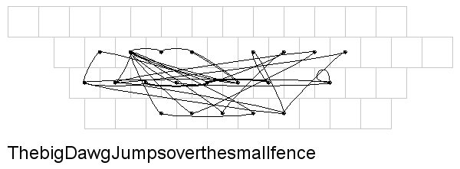
Samples from Data

Slide 17
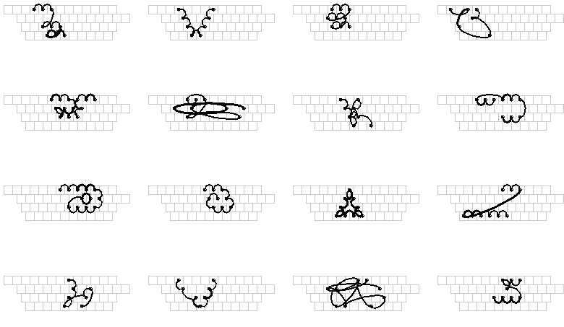
Looking for Common Patterns

Slide 18
Identified Patterns
Pattern Name | Description
Doubles | Same key pressed twice in succession
Triples | Same key pressed three times in succession
Twos | Two keys in a continuous line
Threes | Sets of three keys in a continuous line
Fours | Sets of four keys in a continuous line
Down-the-row | Five or more keys in one row
Snake | Sequence of contiguous keys
Grouped 2/3/4’s | Sets of 2’s, 3’s, 4’s offset by row or diagonal
Split Snake | Two discontinuous snake parts
Reflected | Sequence of mirrored keystrokes
Zig-zag | Alternating contiguous keys from two rows

Slide 19
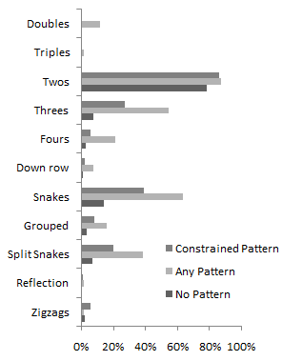
Pattern Frequency
Based on visually identified common patterns
Programmatically checked collected data for frequency
Some interesting results
“Threes” occur often in patterns, seldom in random
Doubles and Triples rare
~20% random passwords had some type pattern

Slide 20
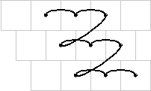
Attacking Patterns
Decided to attack “Grouped 2s/3s/4s”
Occurred in 15% of patterns
Basic approach
Develop rules to generate all possible 2s/3s/4s patterns
Create a dictionary of patterns
Attack using a standard dictionary approach

Slide 21
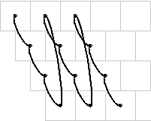
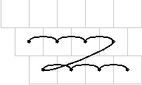
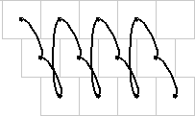
Creating Passwords
Used following rules to generate
Meets locally enforced complexity rules
Password parts (individual sets of 2, 3, or 4 keys in a row) go in the same direction
Password parts are the same length
Password parts are either all shifted up, or all not
Password parts go left to right, or top to bottom
Password parts are only 1 space off on the keyboard
Resulting dictionary had ~500,000 entries

Slide 22
Testing Dictionary
Wanted to test against “live” password file
Difficulty convincing IT group to provide real file (even an old one)
Finally, obtained small production file containing 11 “strong” password hashes
John the Ripper did not discover any of them in 18 hours of run time
Pattern dictionary discovered 2 in under 1 second

Slide 23
Conclusions
Keyboard pattern passwords common
Common pattern elements prevalent
Visualization an effective means to identify common pattern elements
Keyboard pattern passwords susceptible to detection
Can create customized tool to check common patterns
Treat common pattern elements as “words” to create new dictionaries

Slide 24
Visualizing Keyboard Pattern Passwords
Dino Schweitzer, Jeff Boleng,
Colin Hughes, Louis Murphy
Oct 2009

